Slide 1

TransBorder Freight Data Analysis
Insights on Efficiency, Costs and Trends
EBENEZER OMARI

Slide 2
Objectives
Freight Patterns
Operational Efficiency
Environmental Impact
Economic Effects
Data-Driven Solutions
Safety Analysis

Slide 3
Data Overview
Total records: 5,242,875
Time period: 2020 – 2024
Key variables: TRDTYPE, USASTATE, VALUE, SHIPWT, FREIGHT_CHARGES, MONTH, YEAR, COUNTRY
Data Source: Bureau of Transportation Statistics (BTS).

Slide 4
Analysis Framework
Framework Used: CRISP-DM Methodology
Business Understanding: Key questions to address
Data Understanding & Preparation: Cleaning, aggregation and key statistics
Modelling & Evaluation: Insights and trends
Deployment: Recommendations.

Slide 5
Summary Statistics (2020 – 2024)
Total Value of Freight: 15.15 trillion USD.
Total Shipping Weight: 6.24 trillion kilograms.
Total Freight Charges: 200.4 billion USD
Average Freight Charges per Transaction: 38,225.81 USD

Slide 6
Key Findings from the analytical questions:
What are the top modes of transportation by freight volume and value?

Slide 7
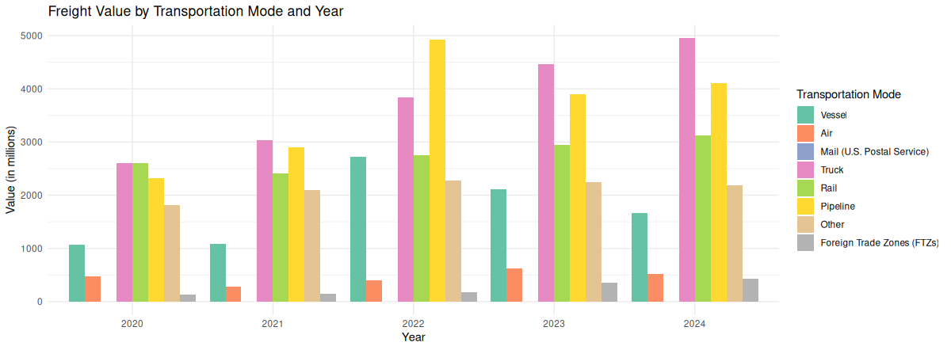

Slide 8
Key Findings and Insights
Trucks dominate the freight value across most years, indicating their importance in domestic and regional transportation.
Air transportation, while less significant in terms of value, consistently contributes a notable portion of the freight value, highlighting its role in high-value shipments.
Pipelines also contribute significantly, particularly for specific years where bulk commodities like oil or goods with high shipping requirements were involved.

Slide 9
Key Findings from the analytical questions:
What is the correlation between Freight Value, Shipment Weight and Freight Charges for each year from 2020 to 2024?

Slide 10
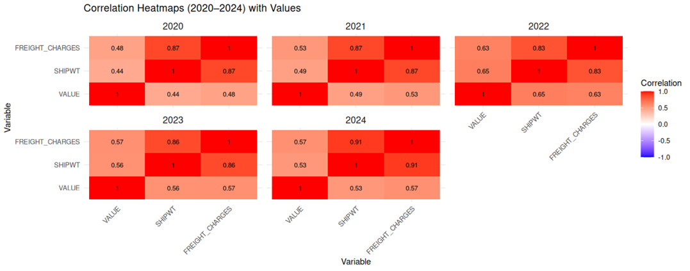

Slide 11
Key Findings and Insights
Shipment Weight and Freight Charges: Across all years, there is a consistently strong positive correlation (above 0.83), with the strongest in 2024 (0.91). This indicates that shipment weight is a critical determinant of freight charges.
Freight Value and Shipment Weight: The correlation is generally moderate, ranging from 0.44 in 2020 to a peak of 0.65 in 2022, and then slightly declining afterward. This suggests that heavier shipments tend to have higher values, but the relationship is not as strong or consistent as with freight charges.
Freight Value and Freight Charges: The correlation is moderate across all years, ranging from 0.48 to 0.63, indicating that while higher-value shipments often result in higher charges, other factors also contribute.

Slide 12
Key Findings from the analytical questions:
How has the total freight value changed over the years from 2020 to 2024?

Slide 13
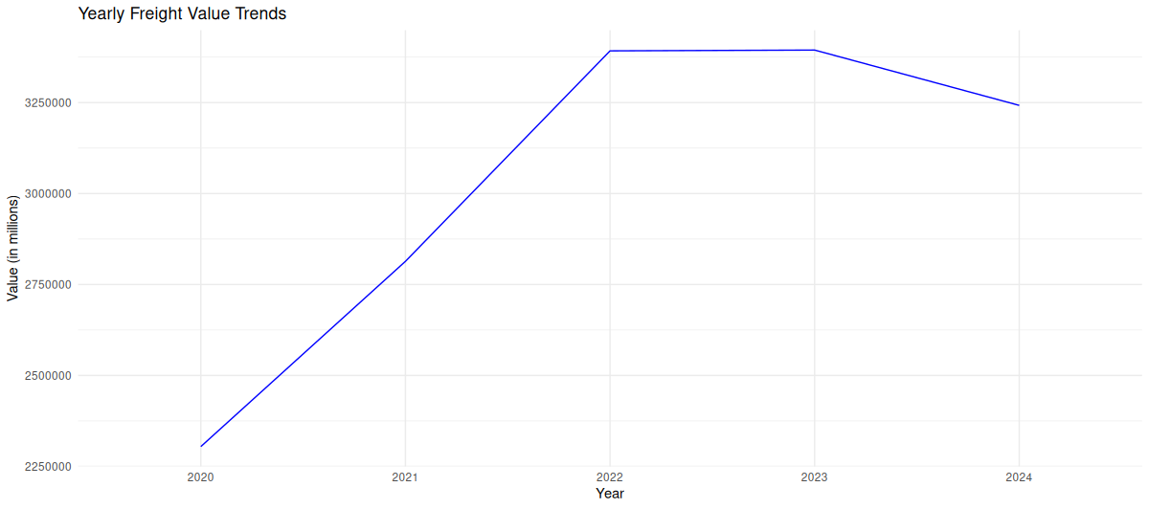

Slide 14
Key Findings and Insights
The freight value increased steadily from 2020 to 2023
Slight decline in 2024
This suggests consistent growth in freight activities or higher-value shipments over the years.

Slide 15
Key Findings and Insights
The significant year-on-year increase from 2020 to 2023 could indicate:
Increased global trade.
An expansion in freight services, especially after 2020 (potentially post-pandemic recovery)

Slide 16
Challenges
Potential data gaps (e.g., missing CANPROV or MEXSTATE entries)

Slide 17
Recommendations
Increase investment in under performing transportation modes or routes
Implement policies to reduce environmental impact (e.g., carbon-neutral transport initiatives)
Monitor freight charges and operational costs more closely to identify inefficiencies

Slide 18
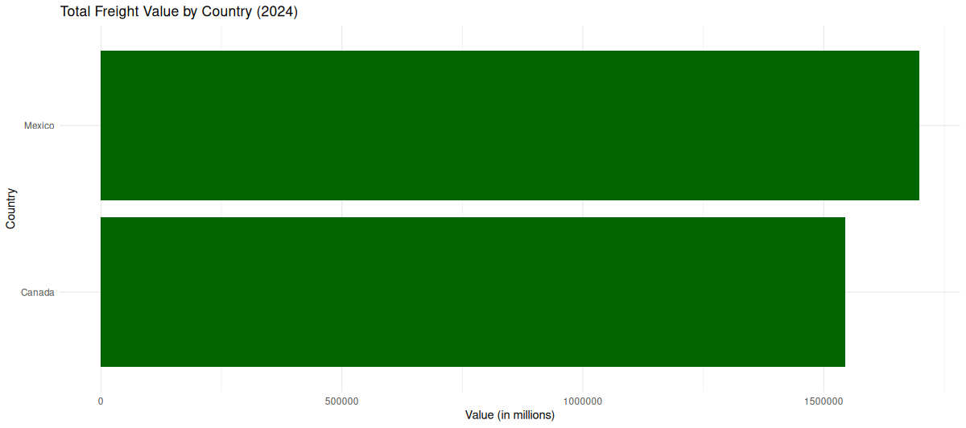
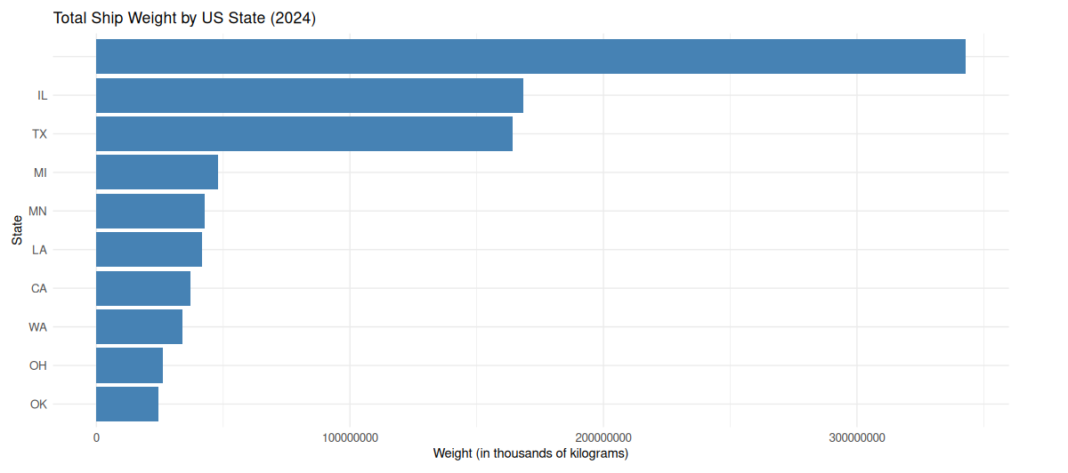
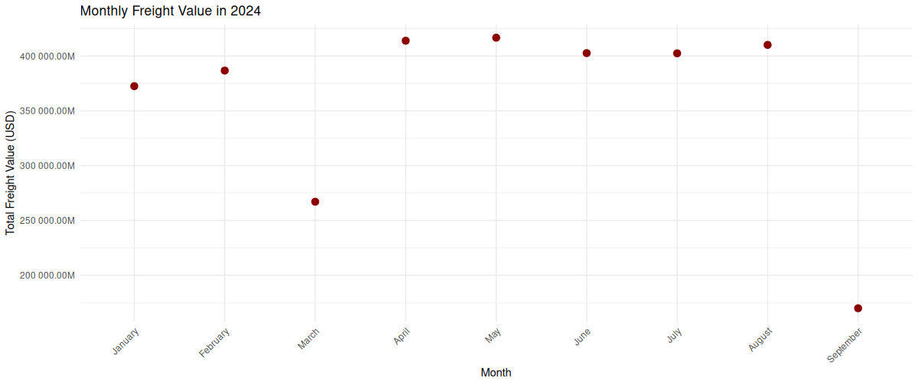
APPENDIX
https://github.com/Kojo-Jr/TransBorder-Freight-Data-Analysis

